Slide 1

Decentralized Health Monitoring with IoT
NAME
Aishwarya Londhe
Vibhav Yavalkar
Krishna Gupta
Tushar Goud
Mahesh Pawasker
Abhijeet Dada Mote

Slide 2
Contents
Introduction
Objectives
Literature Review
Methodology
Result and Dicsussion
Scope
Conclusion
References

Slide 3
Introduction
The project aims to develop a secure and scalable smart health monitoring system by integrating IoT and blockchain technologies to enhance patient care and streamline data management.
The system includes a wristband equipped with sensors to monitor real-time health metrics such as heart rate, oxygen saturation, and body temperature, continuously collecting data via IoT devices like wearable sensors and medical equipment.
The collected health data is securely transmitted and stored on a blockchain network, ensuring data integrity and protection against unauthorized access.
The decentralized framework of blockchain addresses traditional healthcare challenges in data privacy, security, and interoperability. The system enhances data security, transparency, and patient engagement through cryptographic methods and seamless interoperability across platforms.

Slide 4
Objectives
Real-Time Health Monitoring: Implement a wristband equipped with IoT sensors to continuously monitor real-time health metrics such as heart rate, oxygen saturation, and body temperature, and securely transmit this data.
Data Privacy and Security: Leverage blockchain technology to ensure the secure transmission and storage of health data, maintaining data integrity and preventing unauthorized access through cryptographic methods.
Interoperability and Transparency: Design a system that enables seamless data sharing across platforms, improving transparency and integration between healthcare providers, patients, and stakeholders.
Predictive Analysis: Integrate machine learning algorithms to analyze the collected health data and proactively identify potential health risks, enabling early intervention and improved patient outcomes.

Slide 5
Literature Review
Various IoT-based health monitoring systems have been proposed in recent years. Traditional models often use Arduino or Raspberry Pi with centralized data storage, which poses limitations on scalability and security. Some systems include wearable bands that collect vitals and transmit them using cloud services, but they lack predictive capabilities. More advanced models attempt integration with machine learning for prediction, yet fail to secure the data effectively. Our review indicates a gap in real-time predictive systems with decentralized, secure storage that can also support mobile access and alerts.

Slide 6
Methodology
The methodology follows a modular approach. Wearable IoT sensors (MAX30100 and DHT11) collect health data like heart rate, SpO2, and temperature. This data is processed by the ESP32 microcontroller and transmitted to Firebase for cloud storage. A neural network-based machine learning model is trained using vital signs datasets. The model classifies the health status into risk levels. The processed data and predictions are visualized via a mobile application that enables patients and doctors to monitor vitals and receive alerts. Data access and update mechanisms ensure only authorized users interact with the system.

Slide 7
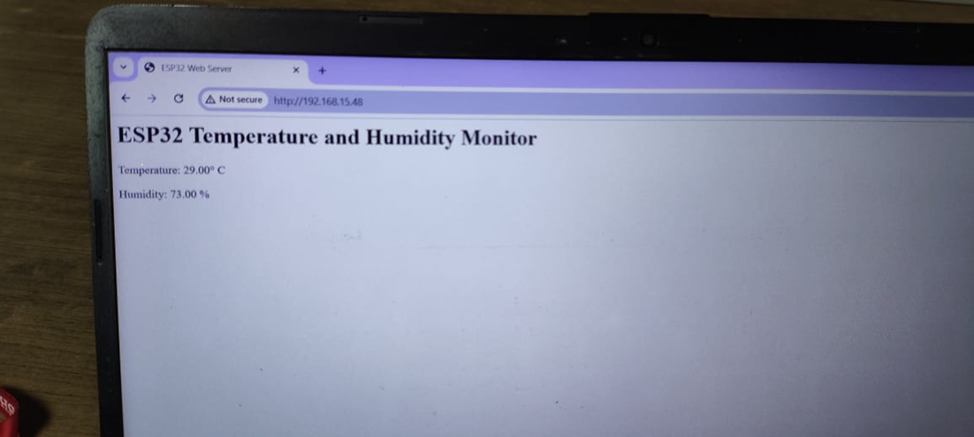
Results and Discussion
The system efficiently tracked and transmitted health data using ESP32. Firebase handled real-time data storage and multi-client access. The ML model demonstrated high accuracy in classifying risk levels. Feature importance revealed heart rate and temperature as key indicators. Real test cases validated the model's accuracy, confirming its utility in real-time health monitoring. The system maintained stable performance even with multiple concurrent users.

Slide 8
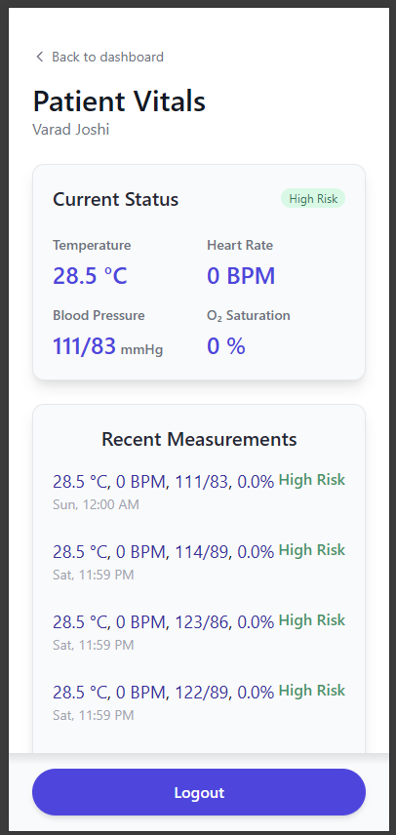
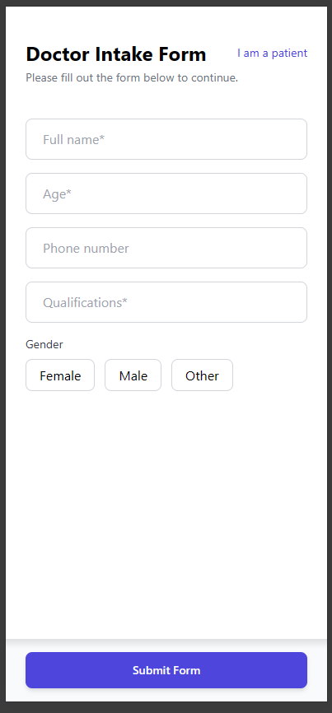

Slide 9
Scope
Real-Time Health Monitoring: The system will use a wristband to track important health data like heart rate, oxygen saturation, and body temperature, providing real-time updates for both patients and doctors
Data Security and Privacy: Using blockchain technology, all health information will be securely stored and shared, ensuring that only authorized people can access the data and that it cannot be tampered with.
Mobile Application Development: Creating a user-friendly mobile application for accessing health data and insights
Data Visualization: Designing intuitive visualizations to present health data effectively.

Slide 10
Conclusion
This project successfully implements a real-time IoT-based health monitoring system, integrating sensor-based data collection, cloud storage, and machine learning for predictive health analysis. Using the MAX30100 and DHT11 sensors with an ESP32 microcontroller, vital signs are transmitted via Wi-Fi and stored in Firebase in structured JSON format. A Django backend fetches this data for preprocessing and classification using a scikit-learn model, categorizing health status into risk levels. The front-end web app, built with HTML, Tailwind CSS, and JavaScript, offers a responsive dashboard with real-time updates and historical tracking. This modular, full-stack AI system demonstrates a scalable, cost-effective solution for non-invasive, remote health monitoring, supporting broader telemedicine applications.

Slide 11
References
[1] Meenu Bala, Mukesh Prasad, Neeraj Kumar, Karan Singh, Karthikeyan Ramasamy, Valentina Emilia Balas, A Secure IoT-Based Modern Healthcare System Using Deep Learning and Chaotic Cryptography, IEEE Xplore, IEEE Access, Vol. 9, 2021, 93546-93562,2021.
[2] S. Varalakshmi, B. Ranjith Kumar, V. Sri Ramya, K. S. Mahendra, D. Sri Ramya, An Intelligent and Secure Health Monitoring System Based on Agent,IEEE Xplore, IEEE Access,Vol. 8,189-197,2020.
[3] Surjeet Dalal, Maninder Singh, Rajesh Verma, An Intelligent Healthcare Monitoring System Using IoT and Fog Computing, IEEE Xplore, 2019 4th International Conference on Internet of Things: Smart Innovation and Usages (IoT-SIU), Conference Paper,1-6,2019.

Slide 12
References
[4] Rajdeep Kumar Nath, Himanshu Thapliyal, Wearable Health Monitoring System for Older Adults in a Smart Home Environment,IEEE Xplore, IEEE Access, 2021.
[5] Rajesh TM, Tina Babu, Rekha R Nair, Nivedha S, Secure Remote Health Monitoring System and assessment using IOT, IEEE Xplore, International Conference on Artificial Intelligence & Data Engineering (AIDE), 2022.
[6] Apratim Shrivastav, Utkarsh Kuchhal, Samarth Singhal, Tanmay Jain, Divyashikha Sethia, Vidushi Chaudhary, Optimised Algorithm for Step Count Estimation Using Sensor Data from Smartphones and Wearables, IEEE Xplore, 2022.
[7] Kaveri Ramesh Dabhade, Kiran Suresh Mulik, IOT based Wearable Smart Health Band Assistance, International Journal of Engineering Research & Technology (IJERT), Vol. 9 Issue 11,2020.

Slide 13
References
[8] Xingdong Wu, Chao Liu, Lijun Wang, Muhammad Bilal, Internet of things-enabled real-time health monitoring system using deep learning, Springer Xplore, 2021.
[9] Shaikh Anowarul Fattah, Mohammad Mahinur Rahman, Nafis Mustakin, Mohammad Tariqul Islam, Asir Intisar Khan, Celia Shahnaz, Wrist-Card: PPG Sensor based Wrist Wearable Unit for Low Cost Personalized Cardio Healthcare System, IEEE Xplore, 2017.
[10] Rangga Adi F, Bambang Guruh I, Sumber, Monitoring Heart Rate And Temperature Based On Internet Of Things, Journal of Electronics, Electromedical and Medical Informatics (JEEEMI) Vol. 1, No. 2, 2019.

Slide 14
Thank You...!!

